Slide 1
Millet vs. millets
Inconsistency of number in popular communication.
Reviews of use of both singular & plural forms within selected webpages & online articles about millets
Ver. 1.0, CC BY-NC-SA 4.0, 5 August 2022

Slide 2
What this is about
Many articles about millets mix usage of the singular & mass-noun form “millet,” with the plural form “millets”
“Millet” is most often read & understood as a singular noun, and grammatically is generally treated as a singular (e.g., “millet is”)
The grains described are actually a group of distinct, though related, species most appropriately considered as a plural – “millets”
The mixing of the two forms in articles can confuse readers
It seems useful to bring some examples together to illustrate the problem, and to raise awareness among writers in order to improve practice as we head into the International Year of Millets (2023)

Slide 3
How this is presented
This presentation shows example images from online articles & webpages, with comments and suggestions
Each article/webpage reviewed is indicated in section title slides, with 1-3 slides following with images & comments
A system of color underlining is used on the images for plural & appropriate singulars, problematic use of singular form, and unclear or ambiguous wording (this system is also noted in footer)
Explanations of the issues identified, and suggestions how the wording could be improved, accompany each image
This presentation does not otherwise review content
The order of the items reviewed is roughly chronological

Slide 4
“Grasses and seeds can be nutritious!”
A selective review of a section of an article by Cathy Newkirk, published online by Michigan State University Extension, 28 Aug. 2015 (1 slide)
https://www.canr.msu.edu/news/grasses_and_seeds_can_be_nutritious

Slide 5
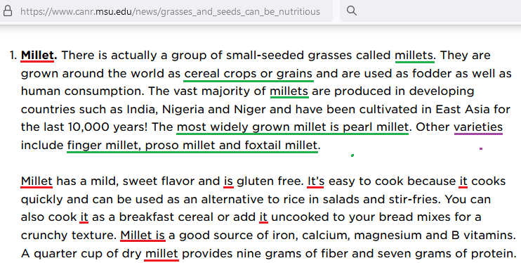
A tale of two paragraphs
This is one section of an article on “millet, teff and amaranth,” which consists of two paragraphs.
This section is presented with the commonly seen singular form “millet,” then uses the plural to describe these grains, followed by discussion of some specific millets.
The term “varieties,” however, often refers to cultivars. Millets are actually different species.
The second paragraph reverts to the singular, contrasting with the previous paragraph, where several millets were mentioned. Discussion of taste, nutritional profiles, fiber & protein content, and cooking characteristics across the several millets certainly presents a challenge, so this part would need a rewrite to harmonize with the previous paragraph.

Slide 6
“Millet: How A Trendy Ancient Grain Turned Nomads Into Farmers”
A selective review of an article by Jeremy Cherfas published online by National Public Radio (NPR.org), 23 Dec. 2015 (2 slides)
https://www.npr.org/sections/thesalt/2015/12/23/460559052/millet-how-a-trendy-ancient-grain-turned-nomads-into-farmers

Slide 7
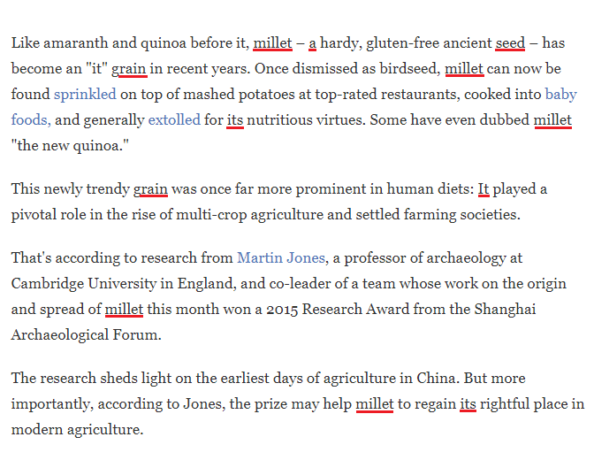
A article taking two approaches
This article begins by discussing “millet” as a single grain, in the title (not pictured) and the first 4 paragraphs. At this point, a reader unfamiliar with the subject would get the clear idea that “millet” is one thing.
It would be fairly straightforward to shift to plurals, but that would make the lede’s comparison with amaranth and quinoa, and its use of the expression “an ’it’ grain,” somewhat awkward.

Slide 8
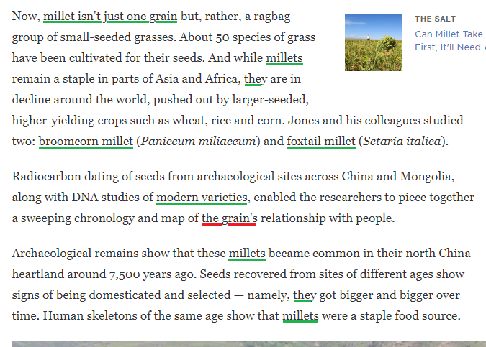
Shifting gears
The article then introduces the fact that “millet” is actually several grains, and continues more or less consistently to use the plural – “millets” – through to the end (there are numerous uses, which will not be shown in this presentation).
One exception is mention of mapping “the grain’s” relationship with people. Since the article just introduced 2 specific millets, this would be more clear as a plural possessive: “the grains’”.
The use in the second paragraph at right of “varieties” – sometimes confusing in other articles when it’s not clear whether different species or cultivars of them are meant – is appropriate here, as it seems to refer to varieties of the two species under study.

Slide 9
“What are millets and can they help create global food security?”
A selective review of an article that appeared on DW.com, 9 June 2022 (3 slides) https://www.dw.com/en/sustainable-agriculture-ukraine-grain/a-61682721

Slide 10
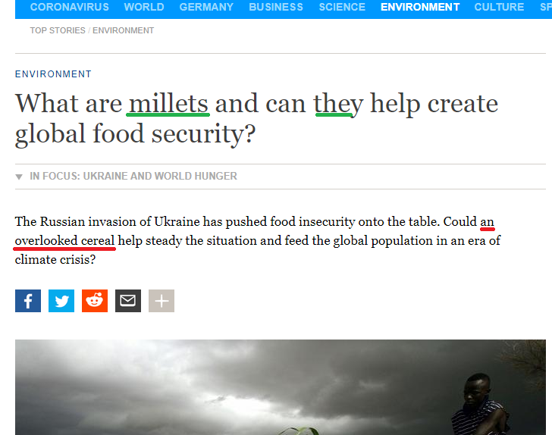
Title & kicker disagree
The title of this piece from DW, “What are millets and can they help create global food security?” is clear: Millets are something plural.
However the kicker then turns around and treats it as one thing: “an overlooked cereal”
Suggested solutions:
“these overlooked cereals”
“this group of overlooked cereals”

Slide 11
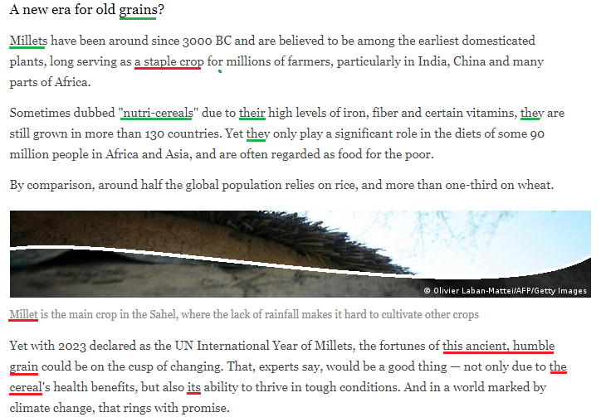
Back & forth in mid-article
This section starts out well, with “grains” in the header and then leading with “millets.” But then in mid sentence there is reference to them as “a staple crop.” Suggested solution: Use “staple crops.”
The next paragraph, devoted to the term coined in India, “nutri-cereals,” is all in plural.
A photo caption then has “millet is the main crop in the Sahel,” where it would have been more helpful to specify “pearl millet.”
Ensuing uses of singular forms could easily be replaced as follows:
“these ancient, humble grains
“these cereals’ health benefits”
“their ability”

Slide 12
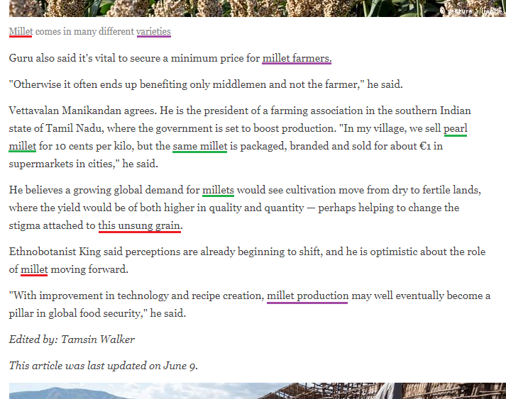
More complicated questions at the end
The picture caption “Millet comes in many different varieties” has, in addition to the singular/plural issue, the term “varieties,” which is more often associated with cultivars. Suggested solution: “Millets are a group of many different crop species.”
After use of the plural and reference to pearl millet (appropriately in singular), two other uses of singular could be readily changed to:
“these unsung grains”
“role of millets” or “roles of millets”
Use of “millet” as a modifier – “millet farmers” & “millet production” – is less of an issue, but could be changed as follows to better harmonize with use of plurals above:
“minimum prices for farmers of millets”
“production of millets”

Slide 13
“Ending edible extinction: Why we need to revive global food diversity”
A selective review of sections of an article by Dan Saladino published on Greenbiz.com, 15 April 2022 (3 slides)
https://www.greenbiz.com/article/ending-edible-extinction-why-we-need-revive-global-food-diversity

Slide 14
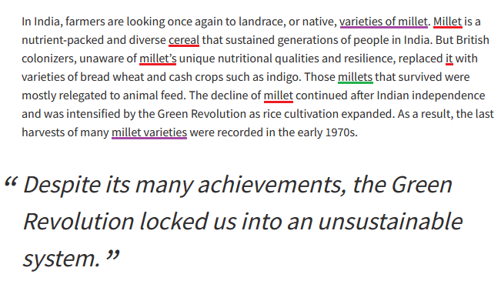
Millets and their varieties
Use of singular (“millet”, “cereal” & pronoun) several times, but shifts to plural “millets” once in mid-paragraph
Reference to singular “millet” could readily be shifted to plural:
“Millets are … cereals”
“millets’ unique nutritional qualities”
“The decline of millets”
In this context, “varieties of millet” & “millet varieties” are ambiguous – millets are entirely different plants, not varieties of a generalized “millet.” However, each millet has its own varieties

Slide 15
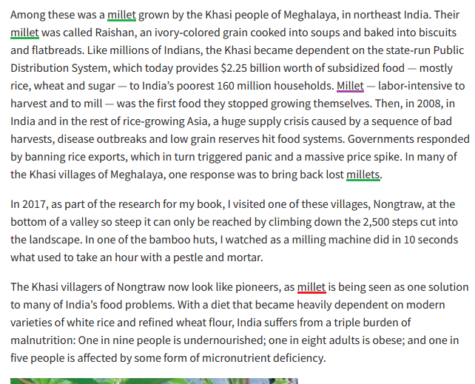
Sometimes, the singular is appropriate
In the first paragraph, reference is to a specific kind of millet (raishan, Digitaria compacta), so the singular is appropriate
The 3rd use is ambiguous, however. Clearer to use “Raishan millet – labor intensive …”
Shift to “millets” at end of the paragraph is consistent.
However in the third paragraph, the singular “millet” is then used where the plural “millets” would be indicated. In India itself, the plural is fairly consistently used now in promoting this group of grain crops in response to its food problems.

Slide 16
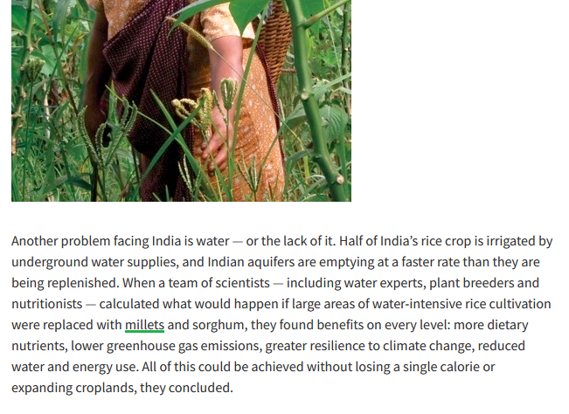
Finishing with using the plural
Following the problematic use of the singular “millet” in the last paragraph on the previous slide, the plural “millets” is used here
Dan Saladino’s article includes important information on millets, but the reader must navigate several shifts in number, some of which make complete sense (when discussing a specific kind of millet), and others of which are inconsistent (e.g., use of “millet” in discussing these cereals’ importance in addressing food issues, but then “millets” when discussing their broader importance wrt water, climate & nutrition)
(The millet held by a woman’s hand in the photo is finger millet - Eleusine coracana)

Slide 17
Millet vs. millets
Don Osborn, East Lansing, MI, US
Version 1.0, 5 August 2022
This work is licensed under a Creative Commons Attribution-NonCommercial-ShareAlike 4.0 International License, https://creativecommons.org/licenses/by-nc-sa/4.0/

