Slide 1
Millet vs. millets
Inconsistency of number in popular communication.
Reviews of use of both singular & plural forms within selected webpages & online articles about millets
Ver. 2, CC BY-NC-SA 4.0, 28 August 2022

Slide 2
What this is about
This is a presentation of a few (6) of the many articles & webpages about millets that mix usage of the singular & mass-noun form “millet,” with the plural form “millets”
“Millet” is most often read & understood as a singular noun, and grammatically is treated as a singular (e.g., “millet is”)
The grains described are actually a group of distinct, though related, species most appropriately referred to in the plural – “millets”
Mixing the two forms in text can confuse readers
Misuse of “varieties” to describe species of millets is a related problem
The goal is to help raise awareness among writers in order to improve practice as we head into the International Year of Millets (2023)

Slide 3
How this is presented
This presentation shows example images from online articles & webpages, with added markup, comments & suggestions
Each article/webpage reviewed is indicated in section title slides, with 1-3 slides following, each with an image & text
Color underlining (also noted in footer) is used on the images for: plural, & appropriate use of singular (& of “varieties”); problematic use of singular form; and unclear or ambiguous wording
Explanations of the issues identified, and suggestions how the wording could be improved, accompany each image
This presentation does not otherwise review content
The order of the items reviewed is roughly chronological

Slide 4
Summary of observations up front
Mixed plural & singular forms (even if latter may be intended as “mass-noun”), with the following patterns:
  Interspersed, or “back and forth” more than once
  Shift from consistent use of one form to another in mid article
  Use of singular form, but brief use of plural before returning to singular
Occasional misuse of “variety” or “varieties” where “species” would be the operant concept – each millet species has its own varieties
  This seems to track with inconsistent use of “millet” & “millets”
Lack of clarity in transitions between, or in reference to, different terms

Slide 5
1. “Grasses and seeds can be nutritious!”
A selective review of a section of an article by Cathy Newkirk, published online by Michigan State University Extension, 28 Aug. 2015 (1 slide)
https://www.canr.msu.edu/news/grasses_and_seeds_can_be_nutritious

Slide 6
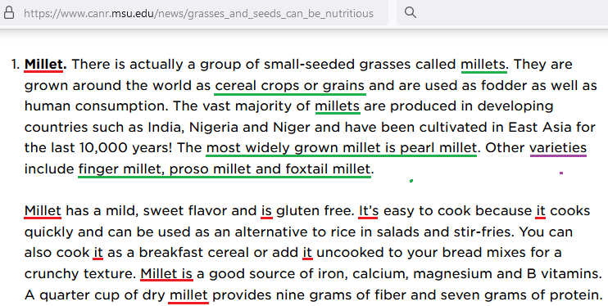
A tale of two paragraphs
This is one section of an article on “millet, teff and amaranth,” which consists of two paragraphs on millets
This section is presented with the commonly seen singular form “millet,” then uses the plural to describe these grains, followed by discussion of some specific millets
The term “varieties,” however, generally refers to subgroups within a species. Millets are actually different species
The second paragraph reverts to the singular, contrasting with the previous paragraph, where several millets were mentioned. Discussion of taste, nutritional profiles, fiber & protein content, and cooking characteristics across the several millets certainly presents a challenge, so this part would need a rewrite to harmonize with the previous paragraph

Slide 7
2. “Millet: How A Trendy Ancient Grain Turned Nomads Into Farmers”
A selective review of an article by Jeremy Cherfas published online by National Public Radio (NPR.org), 23 Dec. 2015 (2 slides)
https://www.npr.org/sections/thesalt/2015/12/23/460559052/millet-how-a-trendy-ancient-grain-turned-nomads-into-farmers

Slide 8
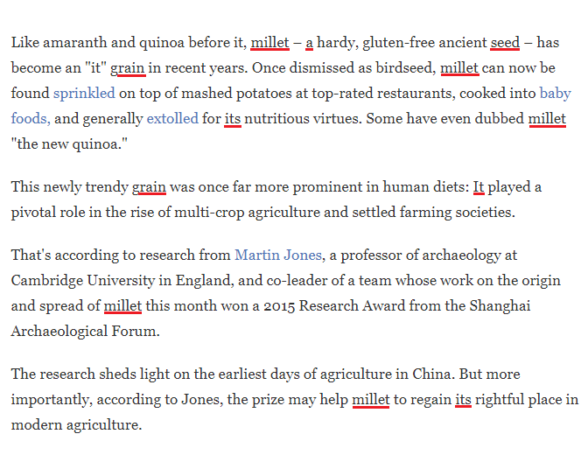
An article taking two approaches
This article begins by discussing “millet” as a single grain, in the title (not pictured) and the first 4 paragraphs (shown at right). At this point, a reader unfamiliar with the subject would get the clear idea that “millet” is one thing
It would be fairly straightforward to change to plurals, but that would make the lede’s comparison with amaranth and quinoa, and its use of the expression “an ’it’ grain,” somewhat awkward

Slide 9
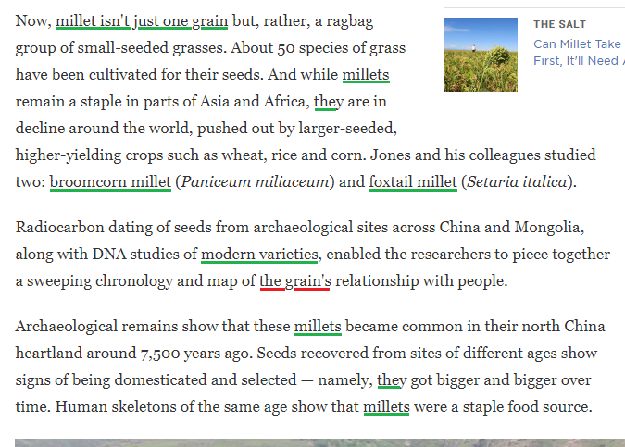
Shifting gears
The article then introduces the fact that “millet” is actually several grains, and continues more or less consistently to use the plural – “millets” – through to the end (there are numerous uses, which will not be shown in this presentation)
One exception is mention of mapping “the grain’s” relationship with people. Since the article just introduced 2 specific millets, this would be clearer as a plural possessive: “the grains’”
The use in the second paragraph at right of “varieties” – sometimes confusing where it’s not clear whether different species or types within a species are meant – seems appropriate here, if indeed it refers to varieties of one or both of the two species under study. (Reference not explicit)

Slide 10
3. “What Is Millet? Nutrition, Benefits, and More”
A selective review of an article by Ariane Lang that appeared on Healthline.com, updated 12 November 2021 (3 slides)
https://www.healthline.com/nutrition/what-is-millet

Slide 11
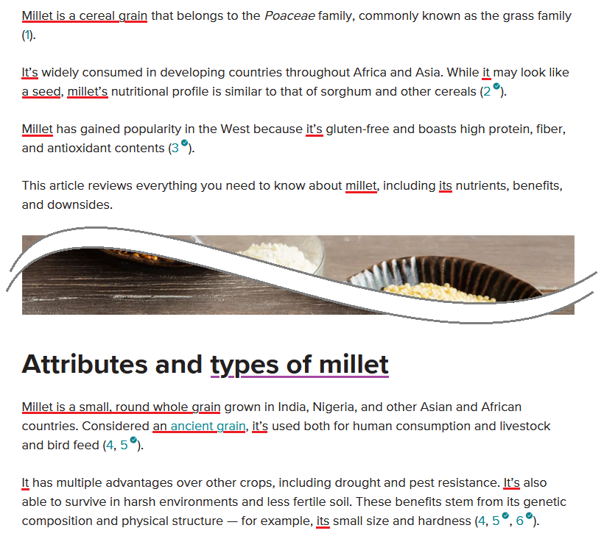
Another article taking two approaches
This article begins with a decent introduction to millets – except that everything is phrased as if the subject were one grain
Changes to plural could be readily done:
Millets are cereal crops…
They’re widely consumed…
… they may look like seeds, millets’ nutritional profiles …
Etc.
The subtitle reference to “types of millet” – itself a bit ambiguous without knowing where the article is going with it after consistent use of the singular – is the lead-in to a shift to use of plurals in following paragraphs (next slide)

Slide 12
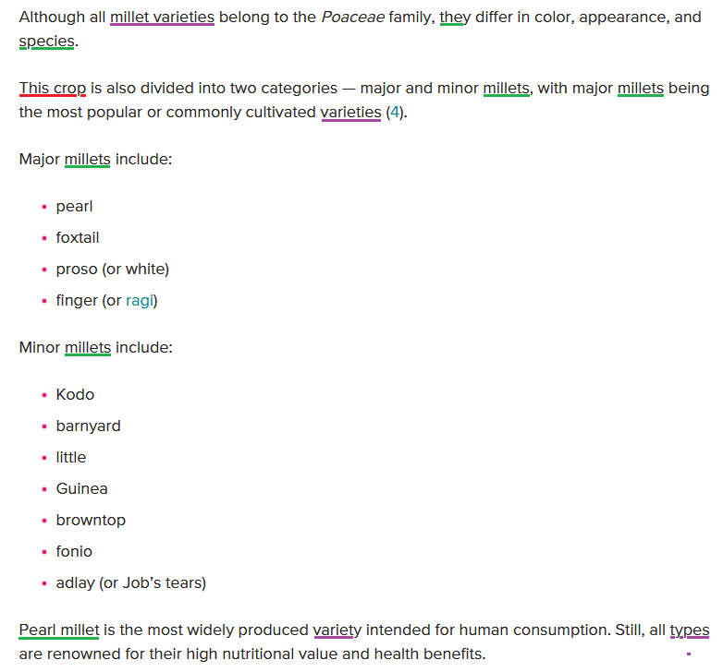
Changing the frame of reference, temporarily
The article then introduces the plurality of millets, but as “varieties” or “types,” which again are refer to variations within a species
“Species” is actually mentioned, which is a positive, but as a subordinate distinction to variety (reverse of what one would expect). And the opportunity is missed to use “species” to explain the helpful lists of specific millets that follow.
Also, in the midst of the reference to the plurality of millets, there’s another singular reference – “this crop”
Rewrites here would refer to “these crops” and center the concept of species, above varieties, in discussing the plurality of millets

Slide 13
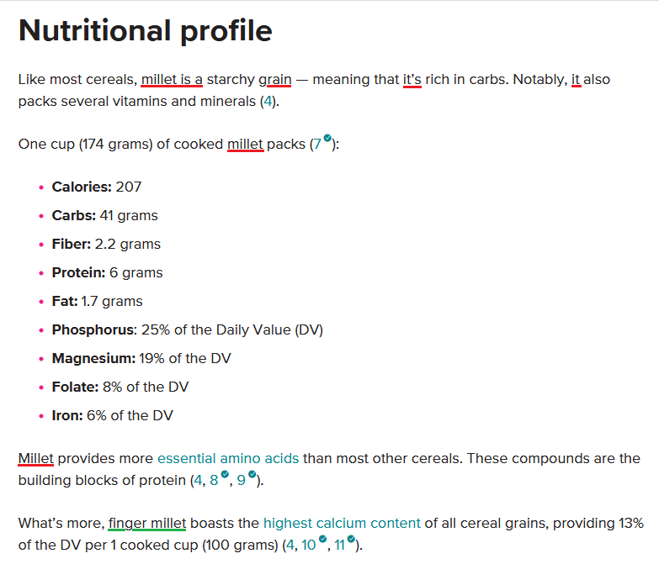
Retreat to the singular
But then the article reverts to treating millets as one grain, beginning with this discussion of nutrition – something that does vary among species of millets
In fact, the nutritional profile may be for one specific millet, but we aren’t told which one
The reference to calcium content of finger millet (an appropriate use of the singular) hints at the nutritional variation, but there was no effort to expand on that theme
The rest of this article refers to these grains in the singular form
This is actually a good article overall, in terms of its coverage of different aspects of millets. However, the predominant use of the singular undercuts its utility, & risks giving the misimpression that this is basically one grain rather than a group of grains
In this context, the brief shift to treating diverse millets (previous slide) may raise more questions for readers than it answers

Slide 14
4. “What are millets and can they help create global food security?”
A selective review of an article that appeared on DW.com, 9 June 2022 (3 slides) https://www.dw.com/en/sustainable-agriculture-ukraine-grain/a-61682721

Slide 15
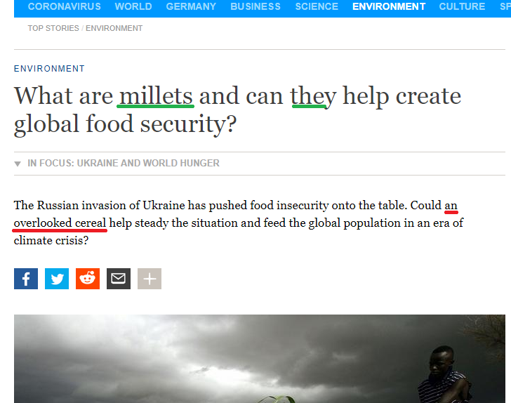
Title & kicker disagree
The title of this piece from DW, “What are millets and can they help create global food security?” is clear on this fact: Millets are something plural
However the kicker then turns around and treats it as one thing: “an overlooked cereal”
Suggested solutions:
“these overlooked cereals”
“a group of overlooked cereals”

Slide 16
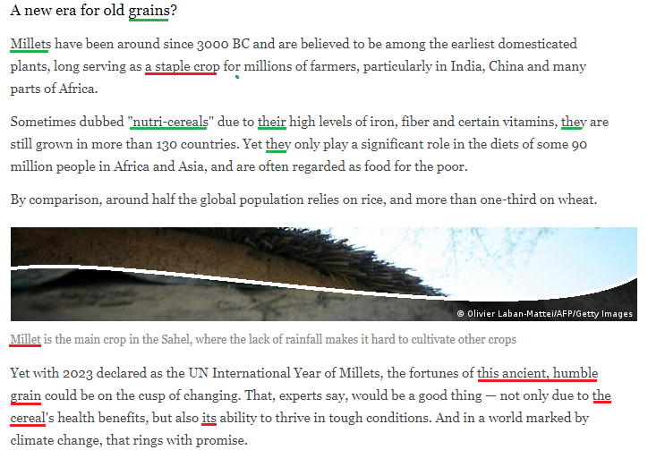
Back & forth in mid-article
This section starts out well, with “grains” in the header and then leading with “millets.” But then in mid sentence there is reference to them as “a staple crop.” Suggested solution: Use “staple crops”
The next paragraph, devoted to the term coined in India, “nutri-cereals,” is all in plural.
A photo caption then has “millet is the main crop in the Sahel,” where it would have been more helpful to specify “pearl millet”
Ensuing uses of singular forms could easily be replaced as follows:
“these ancient, humble grains
“these cereals’ health benefits”
“their ability”

Slide 17
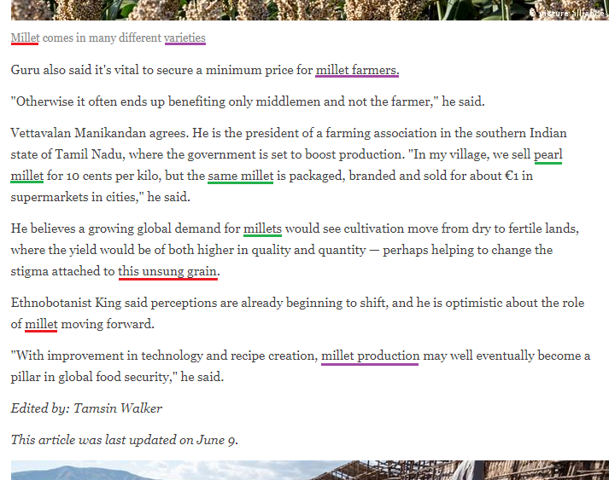
More complicated questions at the end
The picture caption “Millet comes in many different varieties” has, in addition to the singular/plural issue, the term “varieties,” which is usually associated types within a species. Suggested solution: “Millets are a group of many different crop species”
After reference to pearl millet (appropriately in singular) and use of the plural, two other uses of singular could be readily changed to:
“these unsung grains”
“role of millets” or “roles of millets”
Use of “millet” as a modifier – “millet farmers” & “millet production” – is a more nuanced issue, but one could be modify the phrasing as follows to better harmonize with use of plurals above:
“minimum prices for farmers of millets”
“production of millets”

Slide 18
5. “Ending edible extinction: Why we need to revive global food diversity”
A selective review of sections of an article by Dan Saladino, published on Greenbiz.com, 15 April 2022 (3 slides)
https://www.greenbiz.com/article/ending-edible-extinction-why-we-need-revive-global-food-diversity

Slide 19
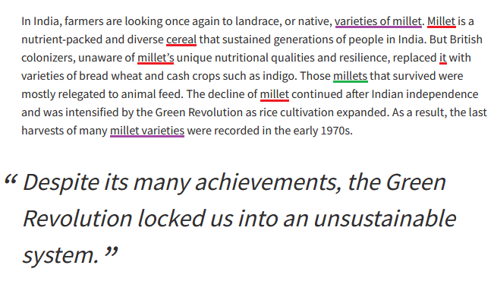
Millets and their varieties
Here we see use of singular forms (“millet”, “cereal” & pronoun) several times, but a shift to the plural “millets” once in mid-paragraph
Reference to singular “millet” could readily be shifted to plural:
“Millets are … cereals”
“millets’ unique nutritional qualities”
“The decline of millets”
In this context, “varieties of millet” & “millet varieties” are ambiguous – millets are entirely different plants, not varieties of a generic “millet.” However, each millet has its own varieties. The first instance would more optimally reference the plural, & thereby also set the context for the second, as it is. So:
“varieties of millets”

Slide 20
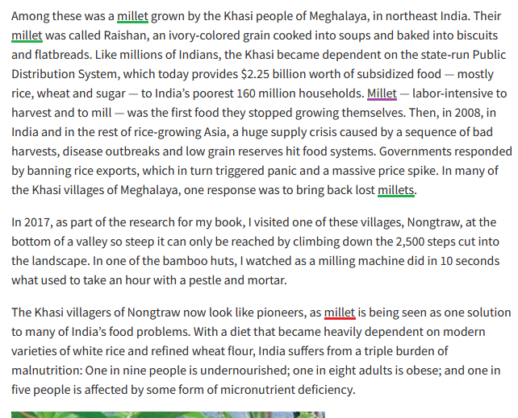
Sometimes, the singular is appropriate
In the first paragraph, reference is to a specific kind of millet (raishan, Digitaria compacta), so the singular is appropriate
The 3rd use is ambiguous, however. Clearer to use “Raishan millet – labor intensive …”
The shift to “millets” at end of the paragraph is consistent
However in the third paragraph, the singular “millet” is then used where the plural “millets” would be indicated. In India itself, the plural is fairly consistently used now in promoting this group of grain crops in response to its food problems

Slide 21
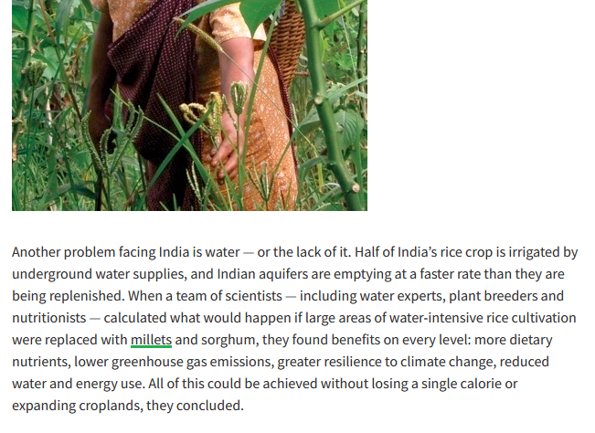
Finishing with using the plural
Following the problematic use of the singular “millet” in the last paragraph on the previous slide, the plural “millets” is again used here
This article includes important information on millets. But the reader must navigate several shifts in number. Some of these make complete sense (when discussing a specific kind of millet), while others are potentially confusing (e.g., use of “millet” in discussing these cereals’ importance in addressing food issues, but then “millets” when discussing their broader importance wrt water, climate & nutrition)
(The plant held by a woman’s hand in the photo is another millet, called ragi or finger millet – Eleusine coracana)

Slide 22
6. “The revival of millets is improving the lives of tribespeople in Odisha”
A selective review of an article by Gurvindar Singh that appeared on Lifegate.com on 19 August 2022 (1 slide)
https://www.lifegate.com/revival-of-millets-improving-conditions-tribespeople-in-odisha

Slide 23
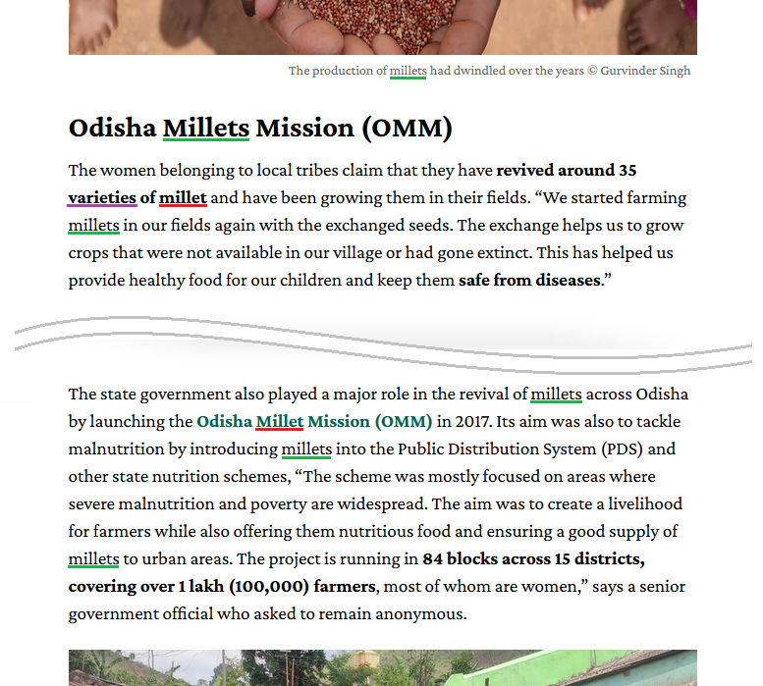
Overall, a good example
This article uses the plural, “millets,” quite consistently
At the same time, it uses the singular form, “millet,” as a modifier (“millet farming,” “millet plants,” “millet production”)
However, the reference to “35 varieties of millet” would be more helpful as, say, “35 varieties of 3 millets” (assuming that the three millets mentioned earlier in the article – finger, little, & foxtail – are the only ones involved)
An editing error in the name of OMM (Millet instead of Millets) is an example of the need for attention to the forms used (which a spell check won’t flag)

Slide 24
Millet vs. millets
Don Osborn, East Lansing, MI, US
Version 2, 28 August 2022
This work is licensed under a Creative Commons Attribution-NonCommercial-ShareAlike 4.0 International License, https://creativecommons.org/licenses/by-nc-sa/4.0/

